Slide 1
Subjective Questions
From your analysis of the categorical variables from the dataset, what could you infer about their effect on the dependent variable?
Ans:
Most of the people took bikes in the year 2019.
Bikes were rented more on non holidays than holidays.
More bikes were rented in the months of June, July, September, October.
Most bikes were rented out in the season of fall, summer, winter and less in spring.
2. Why is it important to use drop_first=True during dummy variable creation?
Ans: Drop_first is used to drop the first column of the dummies where we used to calculate dummies for categorical variables its because we have n levels of categorical variables and dummies are crested as n-1 levels.

Slide 2
3. Looking at the pair-plot among the numerical variables, which one has the highest correlation with the target variable?
Ans: columns temp and atemp have 0.63 correlation.
4. How did you validate the assumptions of Linear Regression after building the model on the training set?
Ans:
By selection of features by correlation function and the heatmap where the columns are correlated with the target variable.
By checking the p-values and VIF values of the features selected and making sure they are not high.
By checking the normally distributed error terms with mean zero.
5. Based on the final model, which are the top 3 features contributing significantly towards explaining the demand of the shared bikes?
Ans:
temp, weathersit 3 and year columns are the top features.

Slide 3

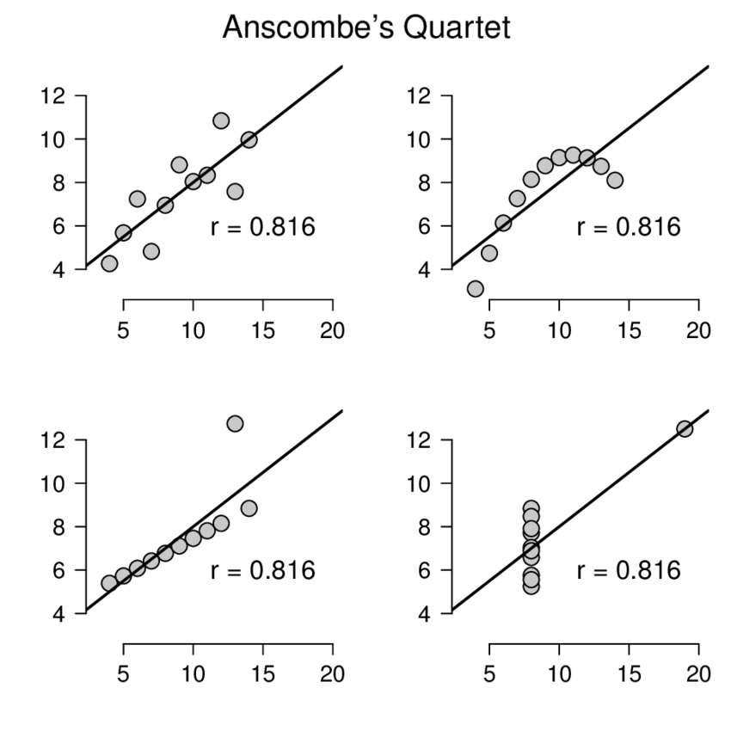
General Subjective Questions
1. Explain the linear regression algorithm in detail?
Ans: It is a regression model which is target prediction value based on independent variables, it attempts to explain the relationship between one or more dependent variables and an independent variable using a regression line.
A simple linear regression is given by the equation Y = β₀ + β₁X
A multi regression is given by the equation
The strength of the linear regression model can be measured using 2 metrics:
R² or Coefficient of Determination
Residual Standard Error (RSE)
2. Explain the Anscombe’s quartet in detail?
Anscombe's quartet comprises four data sets that have nearly identical simple descriptive statistics, yet have very different distributions.

Slide 4
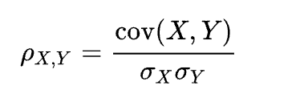
The first scatter plot appears to be a simple linear relationship.
The second graph is a relationship between the two variables is obvious, it is not linear.
In the third graph the modelled relationship is linear.
the fourth graph shows an example when one high-leverage point is enough to produce a high correlation coefficient.
3. What is Pearson’s R?
Ans:
In statistics, Pearson's r, or the correlation coefficient is a measure of linear correlation between two sets of data.
It is the ratio between the covariance of two variables and the product of their standard deviations; thus, it is essentially a normalized measurement of the covariance, such that the result always has a value between -1 and 1.
As with covariance itself, the measure can only reflect a linear correlation of variables, and ignores many other types of relationships or correlations.
Equation is given by

Slide 5
4. What is scaling? Why is scaling performed? What is the difference between normalized scaling and standardized scaling?
Ans:
Scaling is a technique to standardize the independent features present in the data to a fixed range. It is performed during the data pre-processing to handle highly varying magnitudes or values or units.
If feature scaling is not done, then a machine learning algorithm tends to weigh greater values, higher and consider smaller values as the lower values, regardless of the unit of the values.
Also, in cases like MLR, without scaling, it is impossible to understand & interpret multiple coefficients
5. You might have observed that sometimes the value of VIF is infinite. Why does this happen?
Ans:
VIF calculates how well one independent variable is explained by all the other independent variables combined, excluding the target variable
A large value of VIF indicates that there is a strong correlation between the variables (multi-collinearity)
If there is perfect correlation, then VIF = infinity.

Slide 6
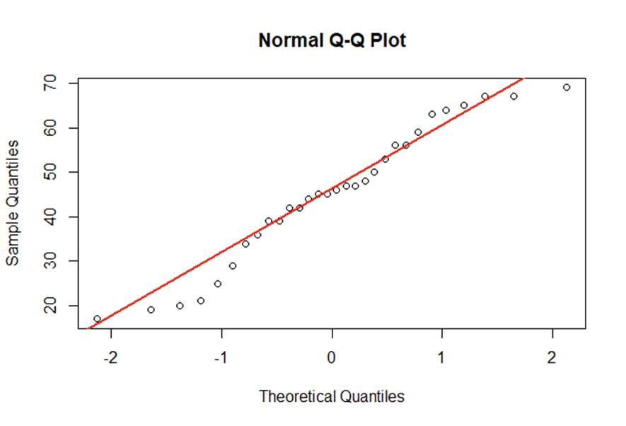
6. What is a Q-Q plot? Explain the use and importance of a Q-Q plot in linear regression?
Ans:
In statistics, a Q–Q plot (quantile-quantile plot) is a probability plot,
a graphical method for comparing two probability distributions by plotting their quantiles against each other.
A point (x, y) on the plot corresponds to one of the quantiles of the second distribution (y-coordinate) plotted against the same quantile of the first distribution (x-coordinate). This defines a parametric curve where the parameter is the index of the quantile interval.
Example of two linearly related distributions

